Slide 1
Self Evolving Competitive Utilitarian Validator (SEC-UV) Test Results
Competing Utilitarian Evolutionary Consensus Algorithm (CUE)

Slide 2
Test Schema
Simulator vs Blockchain
Clique Implementation Comparison
PBFT Implementation Comparison
IBFT Implementation Comparison
QBFT Implementation Comparison
Epoch Limit Influence
Quorum Member Influence Comparison
Network Type Influence
Implicit Variant Performance
Fault Node Influence
Normal Node Behavior
Latency Node Behavior
Malicious Node Behavior: Full Block
Malicious Node Behavior: Partial Block
Malicious Node Behavior: Full Block [100 blocks]
Malicious Node Behavior: Full Block [200 blocks]
Malicious Node Behavior: Full Block [Sine Behaviour]
Overall Comparison
Conclusion

Slide 3
Simulator vs Blockchain Binary Differences
Simulator:
Run Time Memory Database (JVM)
Simple Transaction Payload
No Encoding / Decoding Transaction
Transaction / Message Communication Diffusion in Simple Socket/ Client Threaded module
Hashing Calculation Simple: SHA256
Hashing Calculation simplified
Encryption/ Decryption: RSA
Diffusion of Blocks with only selected transaction(light)
Homogenous Language Plattform and Libraries: Java
Network Type : Mesh which is better to minimise routing latency
(To Enlist More!)
Binary:
Seperate Database in Physical/ Virtual Memory (RocksDB, LevelDB)
Smart Contract Transaction Payload
Encoding/ Decoding Transaction
Transaction / Message Communication Diffusion in Classical P2P Library devP2P, libP2P
Hashing Calculation: KECCAK256
Hashing calculation intensive
Encryption /Decryption: ECDSA
Diffusion of block with all transactions alltime (heavy)
Heterogenous Language Plattform and Libraries: Go, Python, Java
Network Type is heterogenous which depends on nearest less latent neighbours (To Enlist More!)

Slide 4
Altruism ---> Utilitarian
Altruism may be seen as similar to utilitarianism, however an essential difference is that the latter prescribes acts that maximize good consequences for all of society including oneself, while altruism prescribes maximizing good consequences for everyone except the actor.

Slide 5
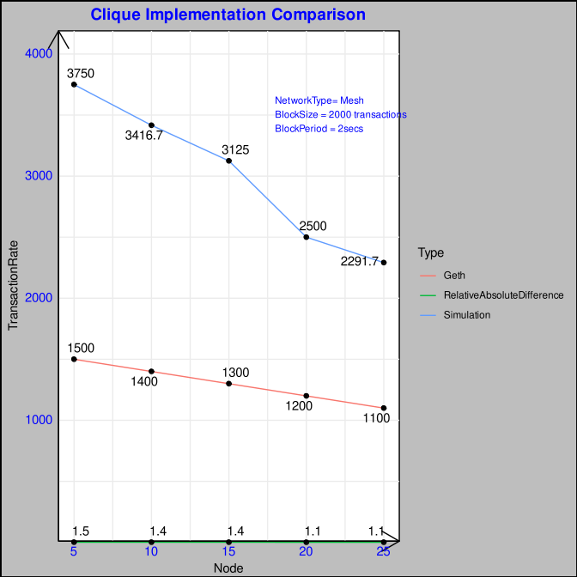
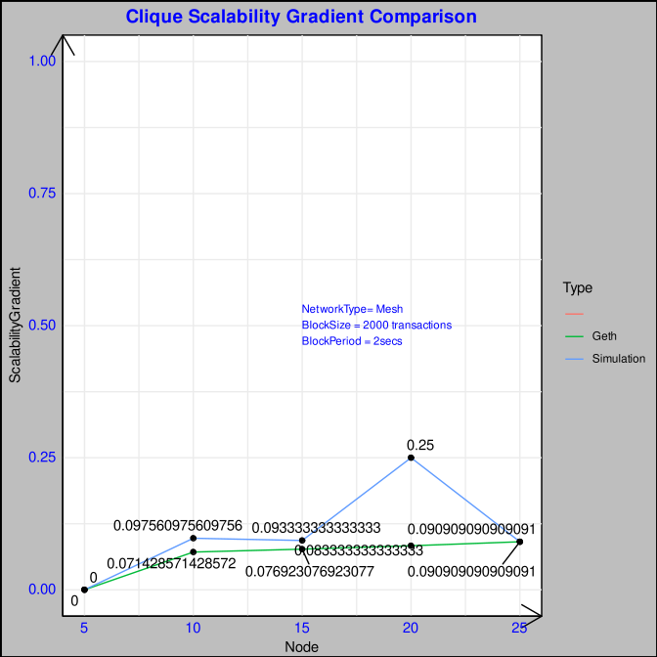
Clique Implementation Comparison
Geth Clique has EVM bottleneck due to smart contract transaction execution.
10 Differences mentioned earlier explain the relative higher transaction per second
*RAD shows an almost uniform variation
There is a general scalability step wise drop in transaction rate attributed to proposer block propagation with more nodes.
Fork occurrence is also a factor
For Simulation: Scalability Gradient is more of similar except for Node 20 Gradient is more higher due to higher communication and fork split.
On the otherhand Geth from the initial of 5 nodes peaks and stays limited due to the bottleneck due to Ethreum EVM , so there is a negligible gradient either higher or lower.
* Scalability Gradient (SG) =
(Previous Value – Current Value) / Current Value
* Relative Absolute Difference (RAD) =
(Simulated Value – Original Value) / Original Value

Slide 6
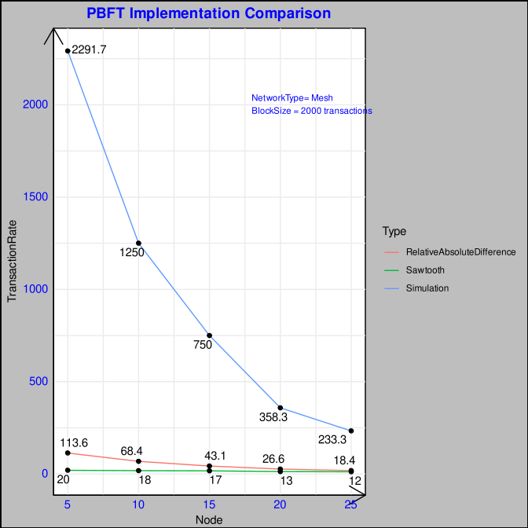
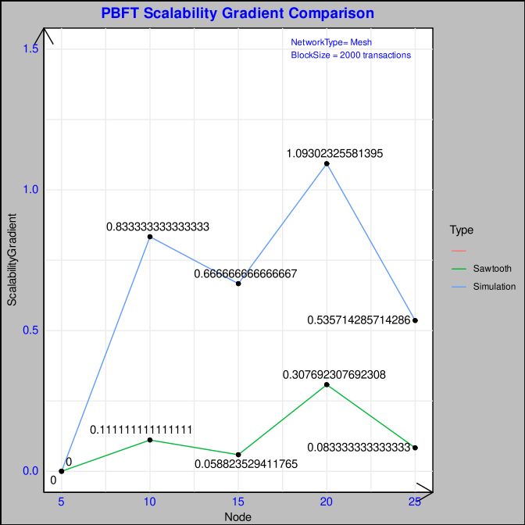
PBFT Implementation Comparison
Sawtooth Simulation has high RAD due to the low performance of python interpreter language and Docker implementation.
Also separation of validator, consensus engine, REST API module and transaction processing builds in communication bottleneck.
PBFT consensus has 4 phases of Pre-Prepare,Prepare,Commit and Round Change which causes high message complexity.
PBFT Gradient is a little higher for simulation due to higher transaction rate and the scalability drop due to increased peers. Each individual gradient plot is quite similar in behaviour respecting the equivalent scalability condition
* Scalability Gradient (SG) =
(Previous Value – Current Value) / Current Value
* Relative Absolute Difference (RAD) =
(Simulated Value – Original Value) / Original Value

Slide 7
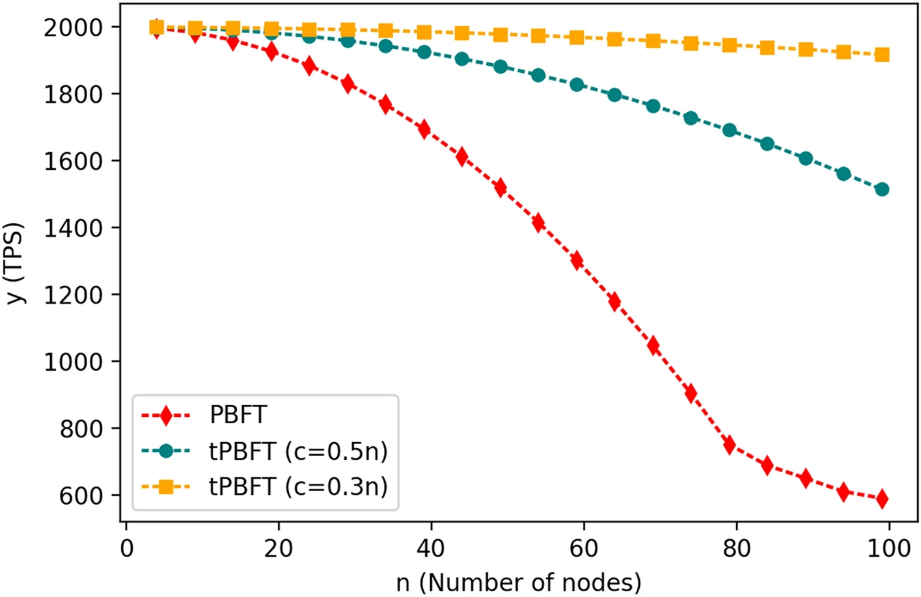
PBFT Implementation Comparison
Experiments show that when the number of consensus nodes in the system exceeds 100, the bandwidth consumption and consensus delay will greatly increase, resulting in the inability of PBFT to be applied. In scenes with many nodes.
For the PBFT commonly used in alliance blockchains, there are some problems, such as large communication overhead, simple selection of master nodes, and inability to expand and exit nodes dynamically in the network.
This paper proposes an improved algorithm tPBFT (trust-based practical Byzantine algorithm), which is suitable for high-frequency trading scenarios of consortium chains.
By introducing a trust equity scoring mechanism between nodes in the network, the list of consensus nodes can be dynamically adjusted. tPBFT simplifies the pre-prepare stage of the PBFT consensus process, and realizes the verification of the hash transaction list in the reply stage, thereby reducing the interaction overhead between network nodes.
Theoretical analysis and experiments show that when the number of nodes in the network is greater than 30, with the further increase of the number of nodes, the improved tPBFT algorithm has a relatively large performance in terms of node communication overhead, consensus efficiency and scalability outperforms the PBFT algorithm.
https://www.nature.com/articles/s41598-022-08587-1
Improved PBFT algorithm for high-frequency trading scenarios of alliance blockchain

Slide 8
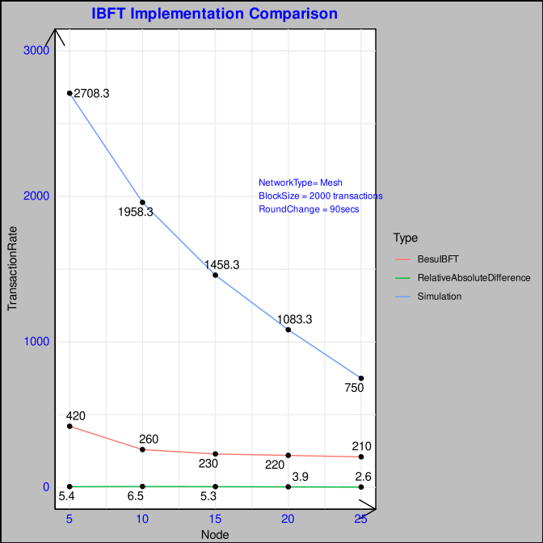
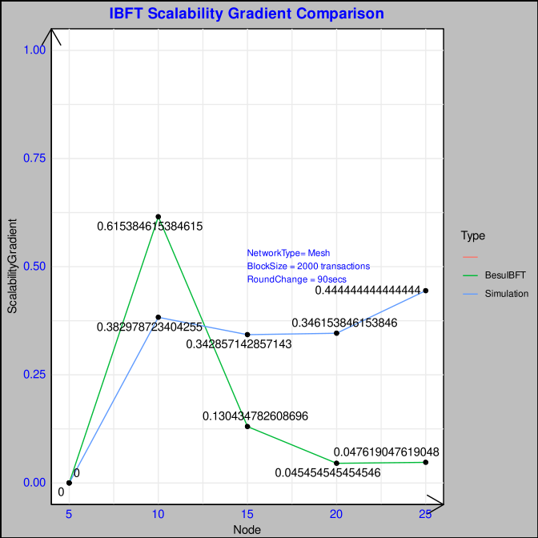
IBFT Implementation Comparison
Besu binary on Analysis has inherent hashing bottleneck which causes the transaction processing to have a uniform scalability performance from 10 nodes.
IBFT has block locking to avoid forks which causes latency and Prepare,Commit, Round Change message complexity.
RAD is little more due to the differences enlisted plus the block stalling more in the client library.
In the gradient plot Besu binary shows a more peek drop from 5 to 10 nodes i.e 420 to 260 whereas in simulation is is less steep 2700 to 1950. In the besu binary implementation the gradient is not much from 15 nodes as it hits the hashing problem added to scalability communication issue around 200.
In the simulator it is a more expected behaviour of gradual drop of transaction finalisation with more nodes.
* Scalability Gradient (SG) =
(Previous Value – Current Value) / Current Value
* Relative Absolute Difference (RAD) =
(Simulated Value – Original Value) / Original Value

Slide 9
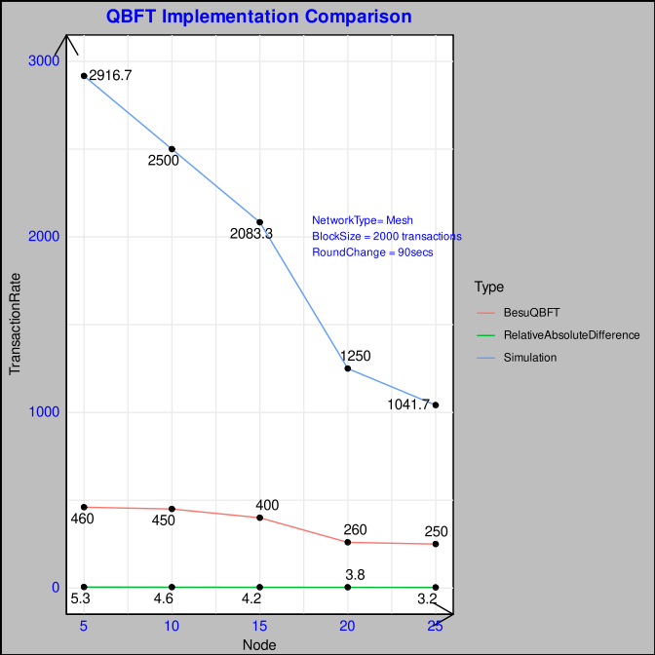
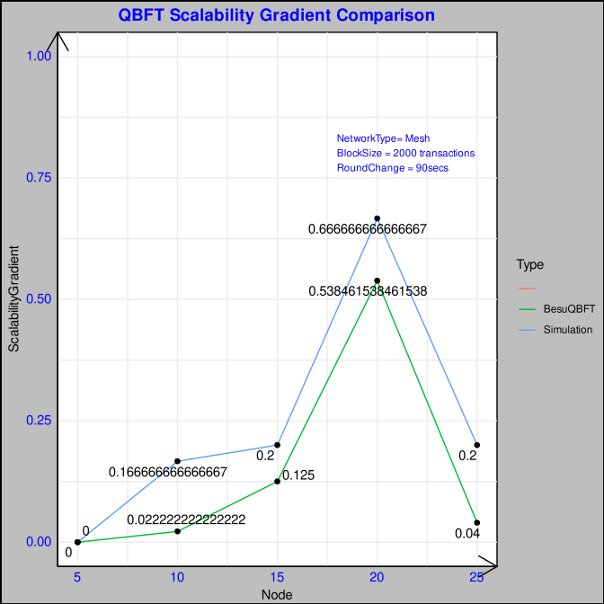
QBFT Implementation Comparison
Besu has inherent hashing bottleneck as already discussed which along with 8 differences has RAD.
QBFT scales well compared to IBFT due to Lesser message communication steps like Propose,Prepare and Commit with timer based round change.
Transaction rate is comparatively a visible drop in the case of simulation which attributes its high gradience.
In the case of binary it drops around to 250 from 400 in the interval of 15 to 20 where the communication load due to scalability is higher than the hashing bottleneck.
* Scalability Gradient (SG) =
(Previous Value – Current Value) / Current Value
* Relative Absolute Difference (RAD) =
(Simulated Value – Original Value) / Original Value

Slide 10
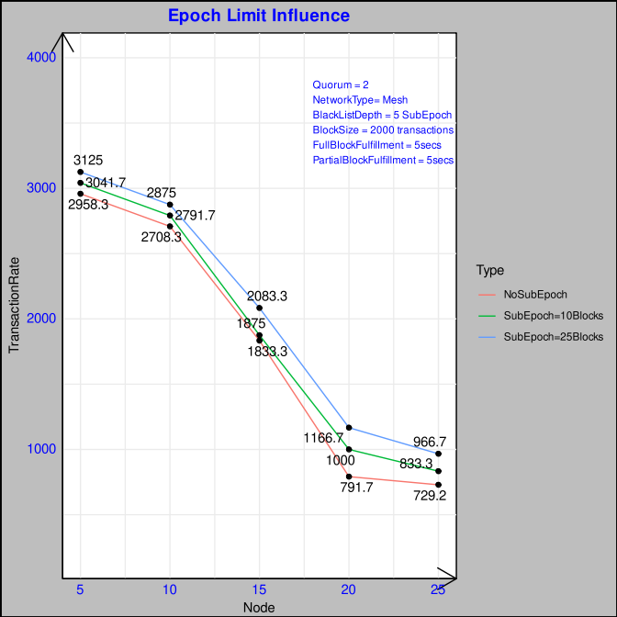
CUPSEC Epoch Limit Influence
Variation based on SubEpoch change which initiates a Quorum formation / reshuffling based on Effective Utilitarian Score in the preceding Epoch.
Quorum Formation:
1) Effective Utilitarian Score = [Proposal + Commit+Heart Beat+Full Block(Positive)] - [Proposal + Commit+Heart Beat+Malicious (Negative)]
2) Active Peer Calculation
3) Forgetting Coefficient Calculation and application on effective score
4)Sorting of Nodes based on effective score
5) Sortition of Node Types as IdealUtilitarian, Utilitarian, FairUtilitarian and WeakUtilitarian
6) Add the node to temp Blacklist
7) Evict the node from Quorum if featured in the last S subepoch as blacklisted
8) Then form the Quorum with the classified node types
All Benign Nodes:
NoSubEpoch has less performance without optimisation. (No Quorum Calculation but unstable in case of adverse nodes/ faulty nodes)
SubEpoch 10 blocks Quorum optimisation takes place but somewhat the gain is compensated by the increasing calculation of Quorum Frequency compared to SubEpoch 25 blocks
Gain (Optimisation) <= Gain (Less Quorum Calculation Frequency) since all benign nodes.
SubEpoch 25 blocks is more optimal at the minimum frequency (Optimal lower limit)

Slide 11
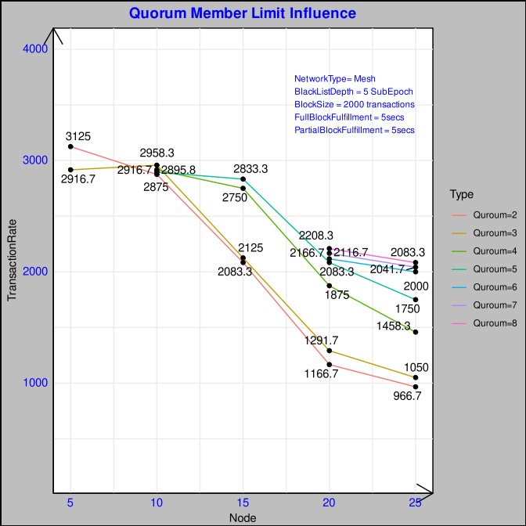
CUPSEC Quorum Member Limit Influence
Consensus takes place in 2 phases:
1) Intra-Quorum Consensus communication for Partial Block [PROPOSE, COMMIT, FINALISE]
2) Inter-Quorum communication for Full Block
Increase in Quorum can increase the partial block parallelization.
Also more Quorum size can decrease the no of intra quorum message communication as inter-quorum is constant complexity at O(1) lower bound and O(2) at upper bound incase of full block fulfiller.
Eg in case of only COMMIT message:
No of Nodes: 20
Case 1: Quorum = 2
Q₁ = 10 | Q₂ = 10
Minimum majority for IntraQuorum = 2/3
==> Q_{n} (majority) = 6
M = Total Majority of Members in Quorum
Intra Quorum Communication = M* (M-1) * No of Quorums
= 6 * 5 * 2
=60
Case 2: Quorum = 5
Q₁ = 4 | Q₂ = 4 | Q₃ = 4 | Q₄ = 4 | Q₄ = 4 |
Minimum majority for IntraQuorum = 2/3
==> Q_{n} (majority) = 2
M = Total Majority of Members in Quorum
Intra Quorum Communication = M* (M-1) * No of Quorums
= 2 * 1 * 5
= 10 (6 time gain due to increase of quorum)
But Quorum members has to be optimal considering the faulty nodes/ adverse probability affecting liveness

Slide 12
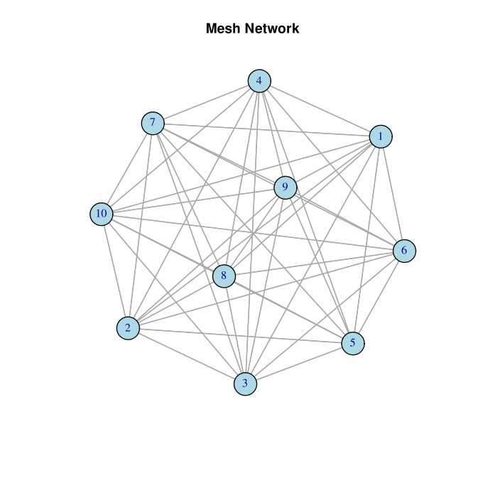
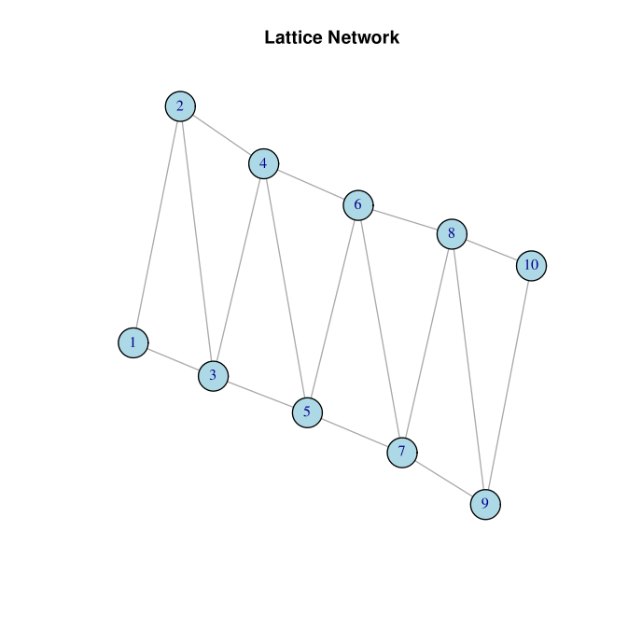
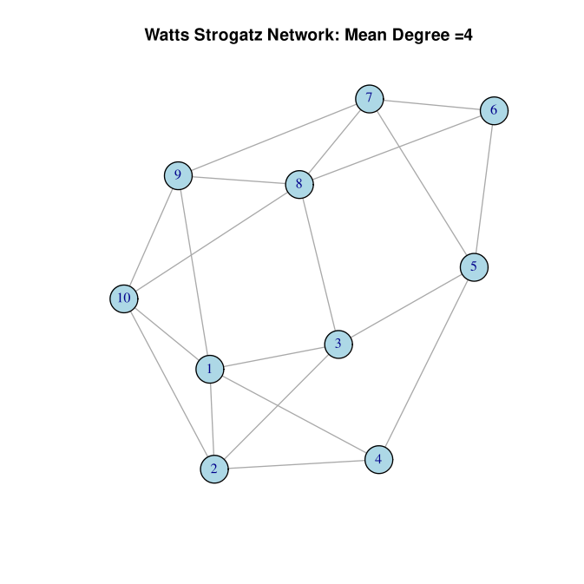
CUPSEC Peer Network Type Influence
Peer to Peer Communication influences the broadcast and reception of message passing in consensus.
Network Type Influence:
Number of Socket Communication Process Management ( Send and Receive)
Routing Latency
Clustering Coefficient
Power Law application to degree of networks or poisson distribution ( independent and constant)
Mesh Network: Full Duplex communication with less latency but at the cost of high socket communication
Lattice Network: Optimal Connection with mean degree (in + out connections)
Watts Strogatz: Short Average Path compared to Lattice (More Ideal)

Slide 13
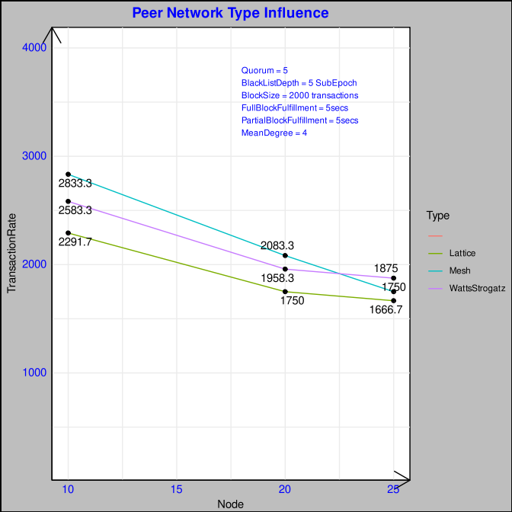
CUPSEC Peer Network Type Influence
Mesh Network Results shows that Lattice has initial better performance for 10 Nodes but decreases in case of 20,25 due to higher open socket connection for receiving and sending messages.
In between Lattice and Watts Strogatz, the latter performs better due to short average distance between nodes
In case of higher no of nodes, Watts Strogatz performs better than mesh or lattice which has a balance of short average distance and reduce number of socket communications.
But we maintain the mesh network during our test as we introduce faulty nodes advertently which might bring in cascading effect for other nodes as well especially the latency factor.

Slide 14
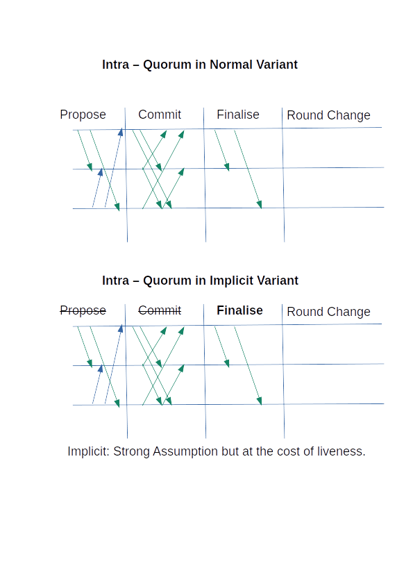
Implicit Variant Comparison
# https://stackoverflow.com/questions/51125238/pbft-why-cant-the-replicas-perform-the-request-after-2-3-have-prepared-why-do

Slide 15
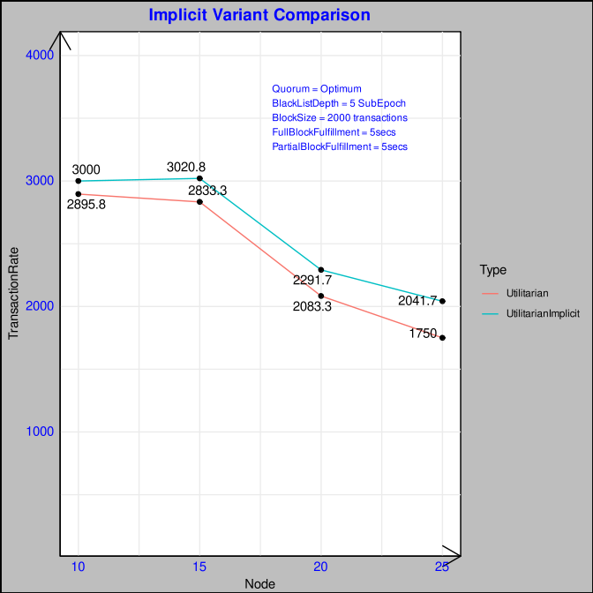
Implicit Variant Comparison
Implicit Variant reduces the Intra-Quorum communication from [PROPOSE, COMMIT, FINALISE] to [FINALISE] partial block.
This finalised partial block is broadcasted to its intra Quorum Members which completes the slot in the ephemeral chain.
This acceptance of finalised partial block by the intra-quorum peers implicitly completes the 2 phases of [PROPOSE, COMMIT]
Although it has a less communication complexity this can ensure synchronisation issues in case the message is lost or delayed violating liveness property.# similar to PBFT requirement of three phases
Difference in performance enlarges as no of nodes increase as message complexity intensifies a bit more for utilitarian variant.
# https://stackoverflow.com/questions/51125238/pbft-why-cant-the-replicas-perform-the-request-after-2-3-have-prepared-why-do

Slide 16
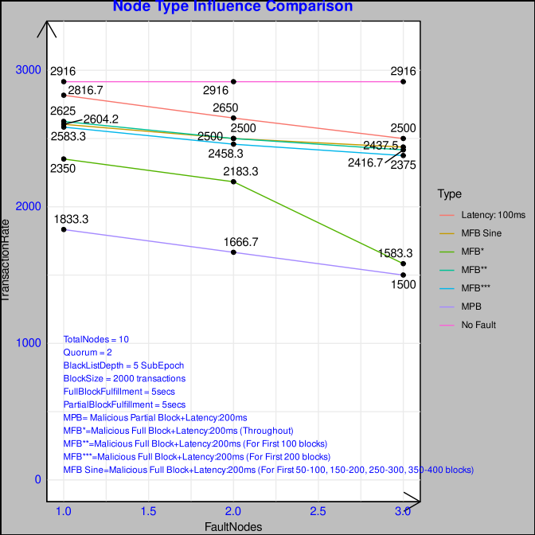
CUPSEC Fault Node Influence
In this test type we introduce 4 types of conditions:
Each case varies with 1,2,3 Nodes in a total of 10 Nodes with 2 Quorums.
Case 1: Latency of 100ms in message communication
Case 2: Malicious Full Block in which signature is falsified with block contents modified and broadcasted along with 200ms latency in communication
Case 3: Malicious Partial Block in which signature is falsified with block contents modified and broadcasted along with 200ms latency in communication.
Case 4: No Fault or Adverse case.
Partial Block Malicious Activity decreases the performance to a much extent than the full block as it slows at the level of ephemeral chain which is detected and the malicious score is increased.
In case of Full Block there is a Fulfiller which runs at 5 secs in case the block is not finalised but in case of a partial block fulfiller the malicious actors inside a quorum has more probability to be chosen as the proposer within a limited set of nodes.
Beyond 3 malicious nodes the network cannot handle as thse total nodes is 10
Case 5: Malicious Full Block + Latency 200ms for 100 blocks or 4 Subepochs
Case 6: Malicious Full Block + Latency 200ms for 200 blocks or 8 subepochs
Case 7: Malicious Full Block + Latency 200ms in sine wave pattern

Slide 17
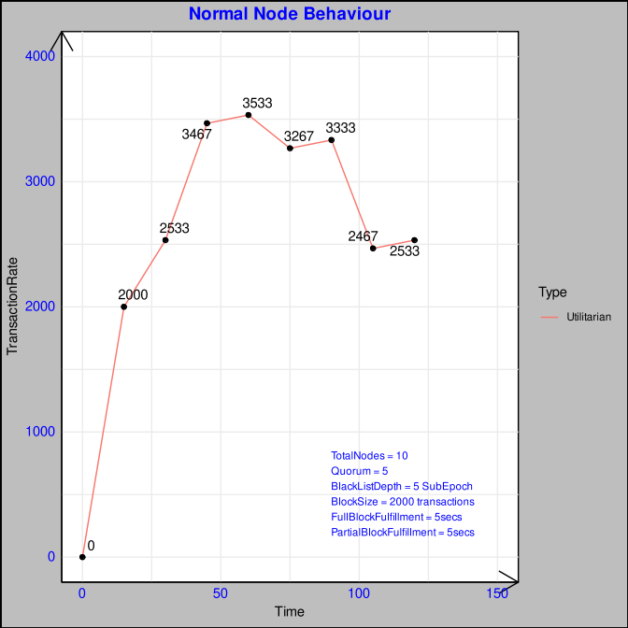
CUPSEC Normal Node Behaviour
In this plot we plot the behaviour of a benign network.
Transaction Rate starts to ascend as it optimises and stabilises from 50 secs until the end of the run.

Slide 18
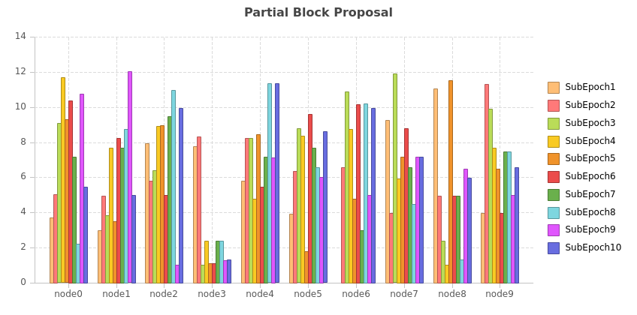
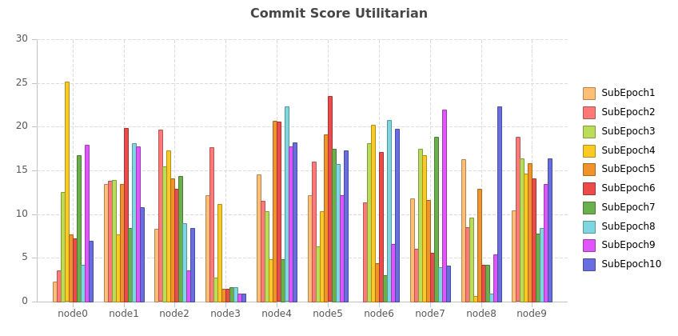
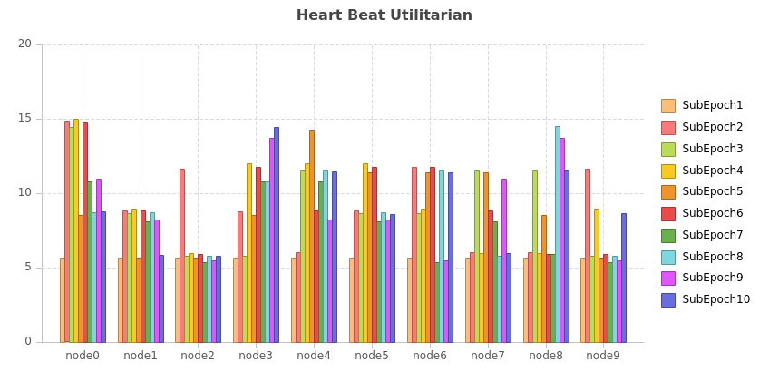
CUPSEC Normal Node Behaviour
Node 3 is comparatively faulty compared with other nodes at fails in the partial block proposal , commit score
Heart beat score is quite normal sent every 5 secs

Slide 19
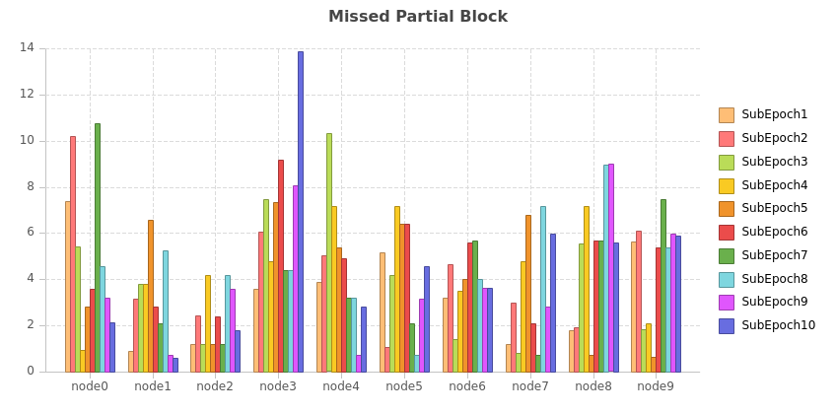
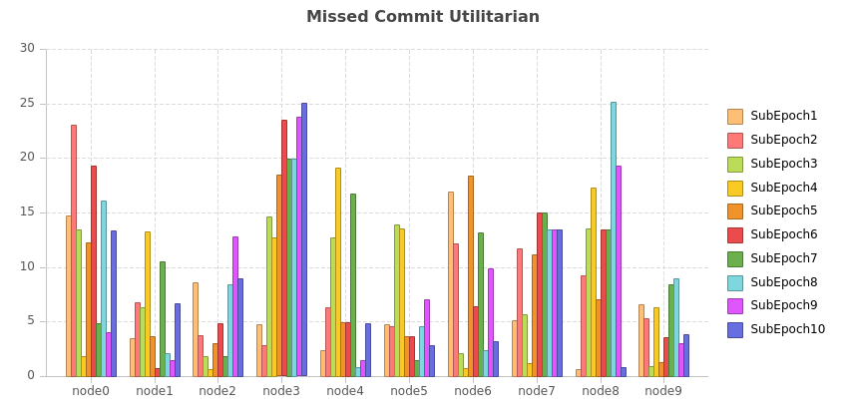
CUPSEC Normal Node Behaviour
Node 3,8 has quite high missed partial block and commit score as is faulty.
Node 3 Fault Behaviour sustains.

Slide 20
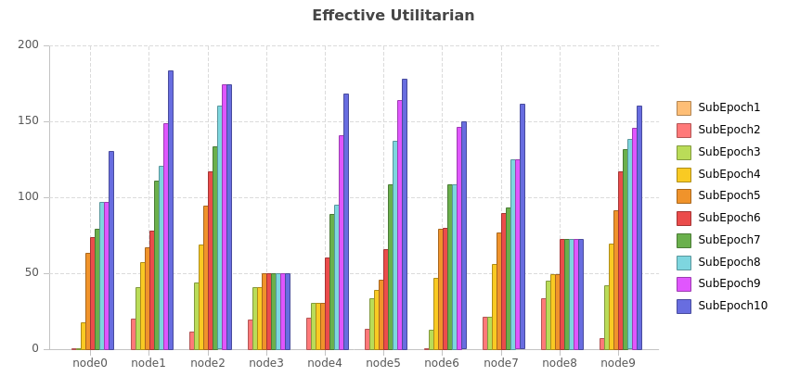
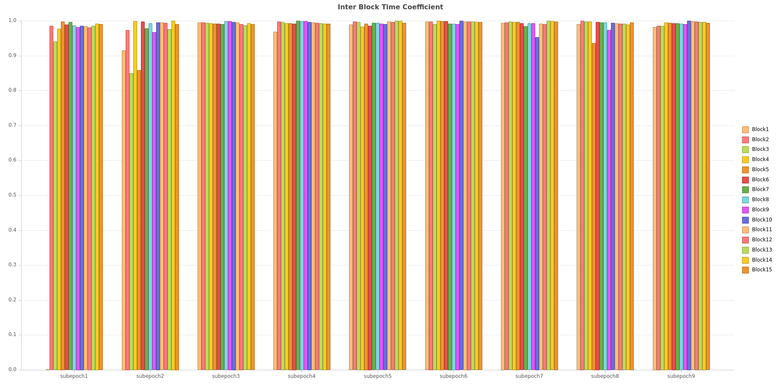
CUPSEC Normal Node Behaviour
Suspended Members= SubEpoch7: Node3 | SubEpoch8: Node8
InterBlockTimeCoefficient(IBC)= 1- [ Current Block Time – Previous Block Time]/100000
Less Block Time Difference ==> High Coefficient
More Block Time Difference ==> Less Coefficient
IBC is multiplicative factor on score (Proposal,Commit)
IBC is comparatively low initially but ascends and stabilises signifying the reduced block time difference. [0 ---- 1]
Inter Block Time difference (IBCD): 213026.0
IBCD Normalised: 2.13026
Default Timecoefficient 1.0E5
---------------------------------------------
Inter Block Time difference (IBCD): 3560.0
IBCD Normalised: 0.0356
Time coefficient: 0.9644
---------------------------------------------------
Inter Block Time difference (IBCD): 10326.0
IBCD Normalised: 0.10326
Time coefficient: 0.89674

Slide 21
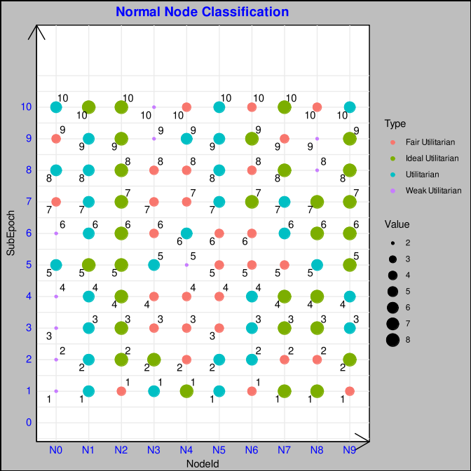
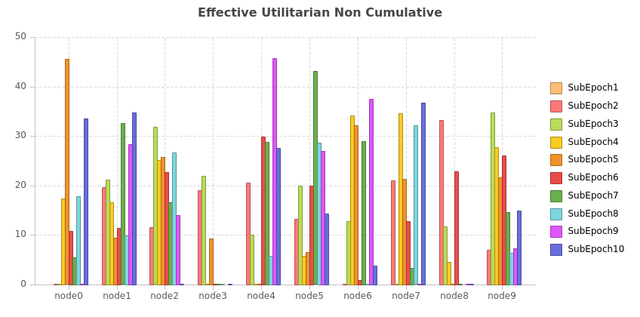
CUPSEC Normal Node Behaviour
Utilitarian Classification | Ideal Utilitarian | Utilitarian | Fair Utilitarian | Weak Utilitarian
Fairness Coefficient (Additive Factor) | 0 | 0.05 | 0.1 | 0.15
Non Cumulative Effective Score ( Representation for Each SubEpoch) = Positive Utilitarian Behaviour – Negative Utilitarian Behaviour
Node 3 , Node 8 – Faulty Behaviour
Their Utilitarian Sortition lands Node3 – Weak Utilitarian | Node 8 – Fair Utilitarian
Node 0 is in intitial Weak Utilitarian phase but ascends to Utilitarian Classification
Node 3 is in Utilitarian phase but descends to Weak Utilitarian
Node4 has a utilitarian lifecycle from Ideal Utilitarian → Fair Utilitarian → Utilitarian → Fair Utilitarian
Node7 has a utilitarian lifecycle from Ideal Utilitarian → Fair Utilitarian → Utilitarian → Fair Utilitarian
Node8 has a utilitarian lifecycle from Ideal Utilitarian → Fair Utilitarian → Ideal Utilitarian →Utilitarian → Ideal Utilitarian → Weak Utilitarian → Fair Utilitarian

Slide 22
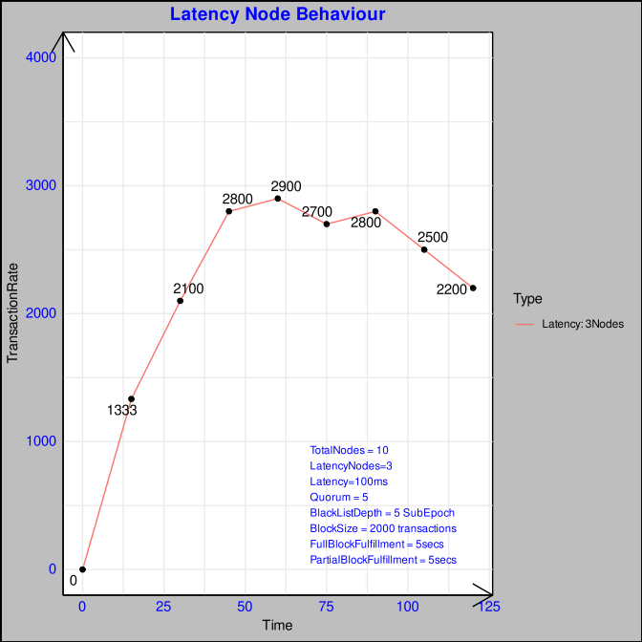
CUPSEC Latency Node Behaviour
Latency Test: 3 Nodes (N7,N8,N9) has a latency of 100 ms for message sending or relay
As this is a conscious adverse behaviour the 3 Nodes continue to inflict a latency into the network.
The Plot starts from a slow ascendancy to a rate lesser than normal behaviour and has a V shaped recovery to stabilise.

Slide 23
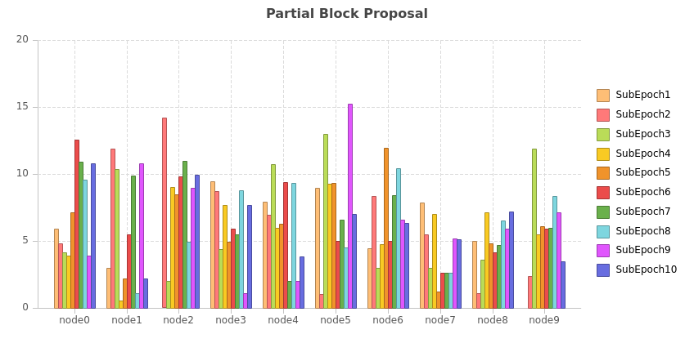
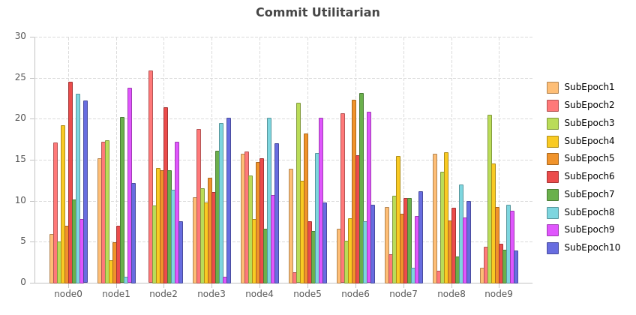
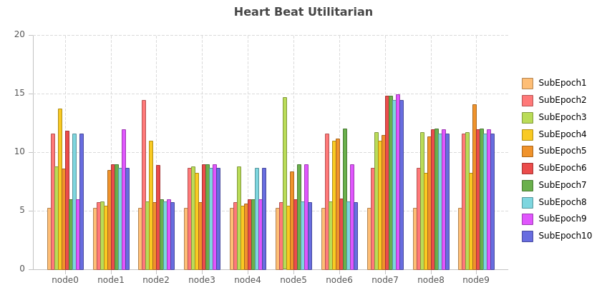
CUPSEC Latency Node Behaviour
Node7, Node8, Node9 has a lesser partial block, commit.
Heart Beat Score is not affected as it is a timer message which is eventually sent and not hot time sensitive.

Slide 24
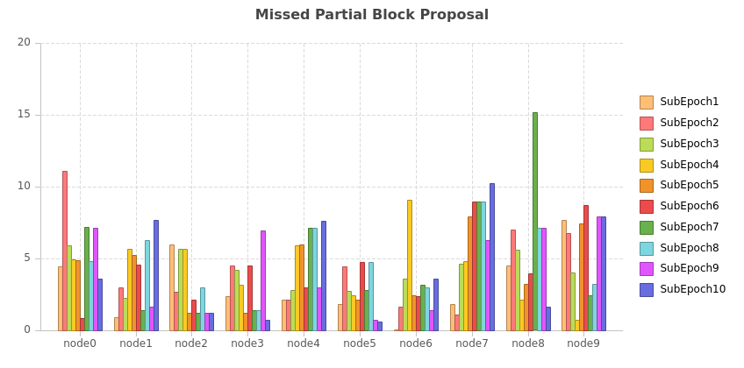
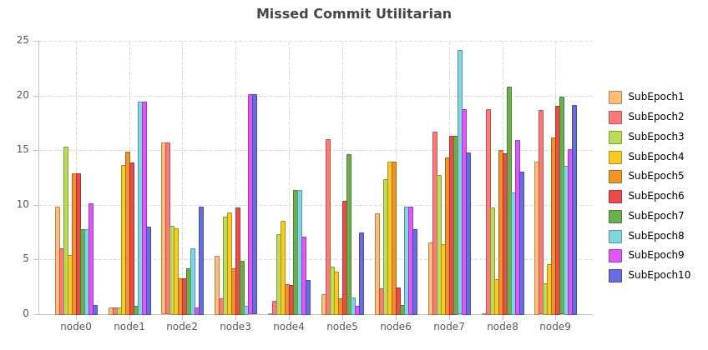
CUPSEC Latency Node Behaviour
Missed Partial Block and Commit Score is high as in Node7,8,9 delays the sending of message.
Since it is not recovery based action as it adds latency on a sustained basis.

Slide 25
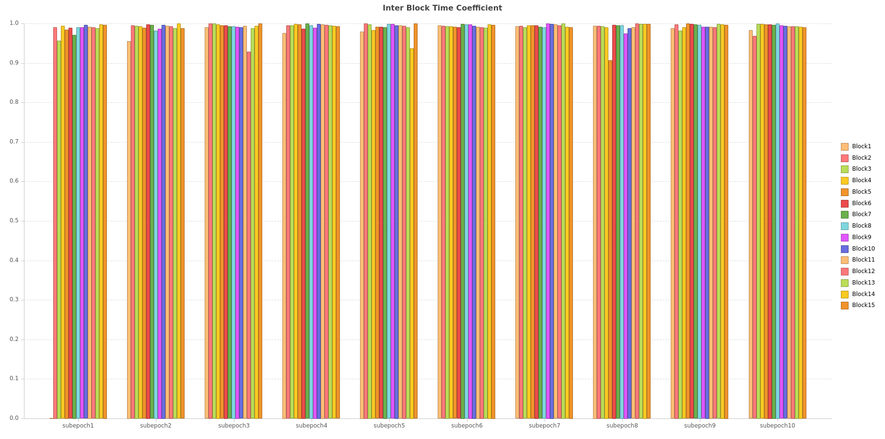
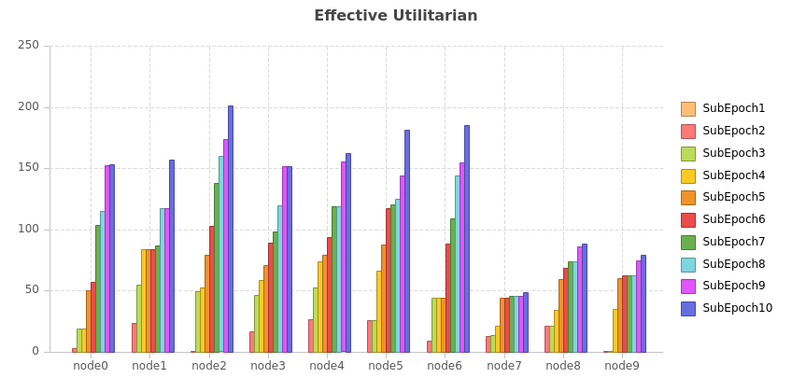
CUPSEC Latency Node Behaviour
Suspended: Node7
IBC is quite spread and uniform due to sustained latency behaviour.
Effective Utilitarian of Node7,8,9 is low due to bad latency action

Slide 26
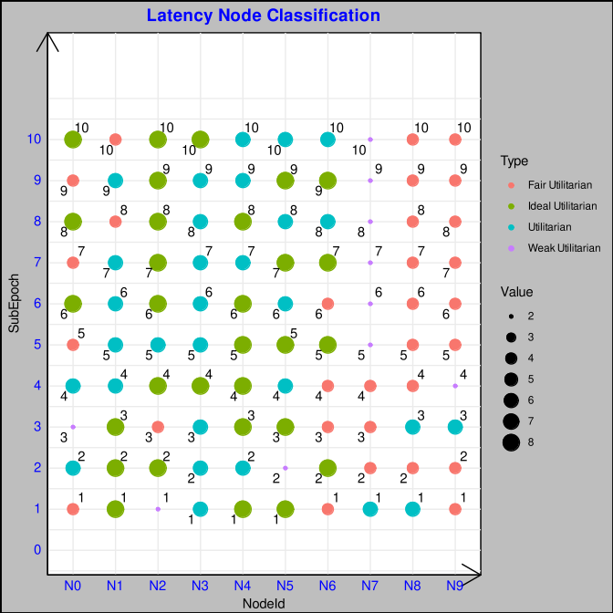
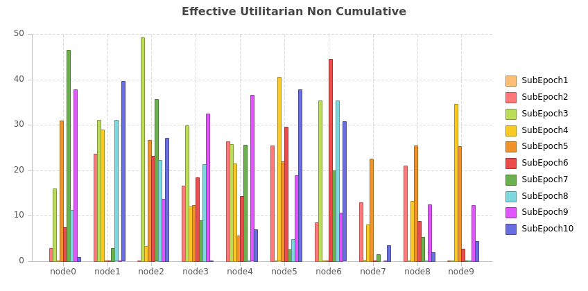
Utilitarian Discussion of Latency Node
Node 7 is suspended as due to latency action and Node 8,9 fall in the last classification of Fair Utilitarian inspite of fairness as they continue their adverse behavior
Also the non cumulative effective score of Node 7,8,9 is low
Fairness Coefficient is not relevant for Node7,8,9 as its conscious behavior
Node 2 ascends from weak to ideal, Node 1 descends from ideal to fair which is quite fair.

Slide 27
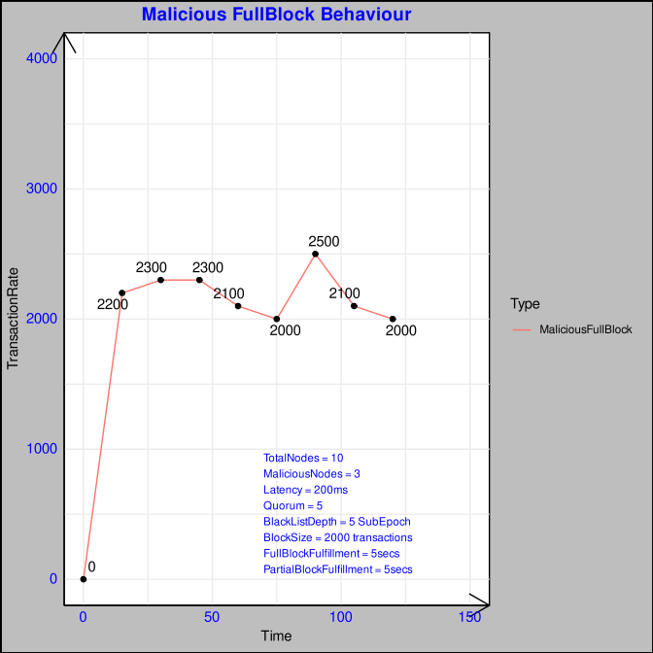
CUPSEC Malicious Node Behavior: Full Block +200ms Latency
Plot has a M shaped behaviour which shows a peak as the malicious block is offset by the full block fulfiller which sustains around 2000 transaction rate

Slide 28
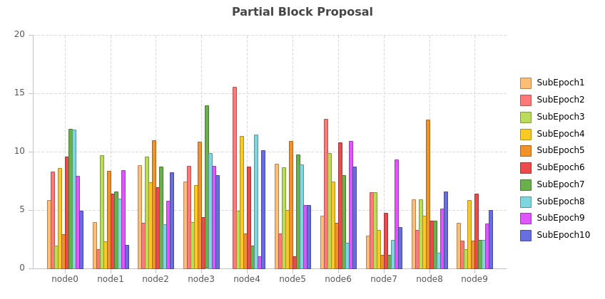
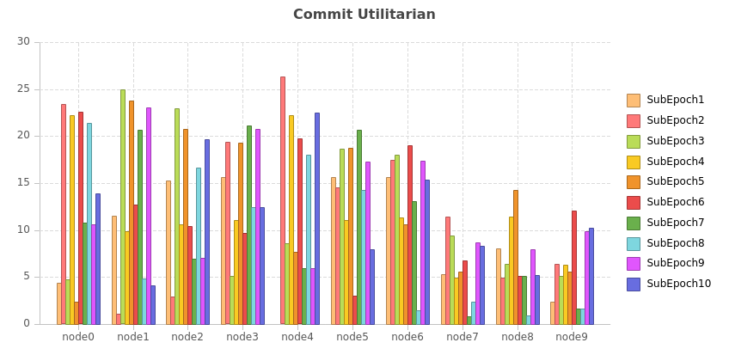
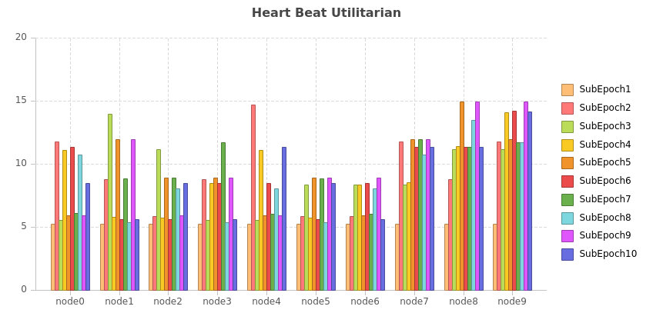
CUPSEC Malicious Node Behavior: Full Block +200ms Latency
Node 7, 8, 9 has a diminished score on the positive front due to the latency inhibition of 200ms but not due to malicious action

Slide 29
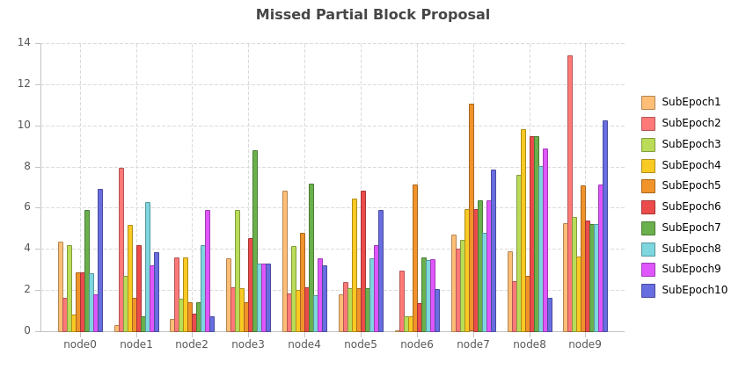
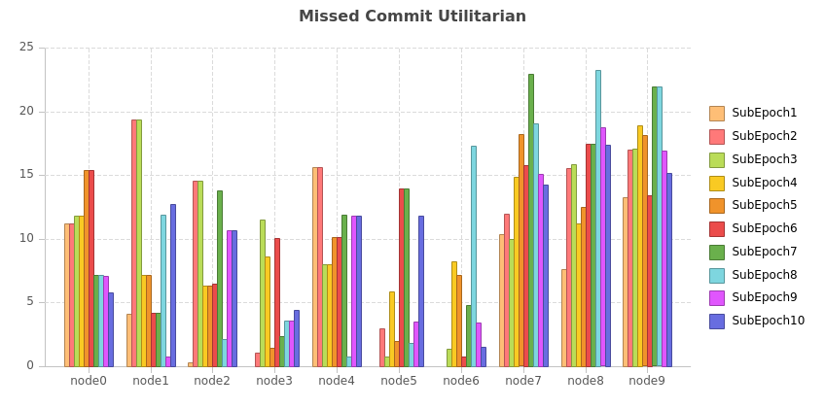
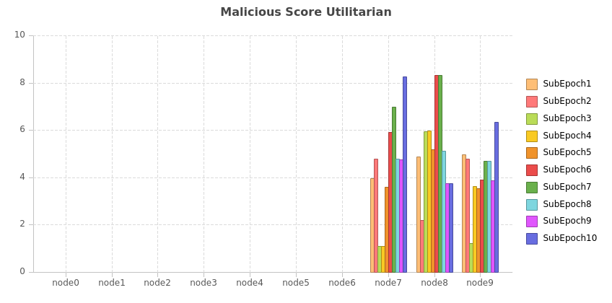
CUPSEC Malicious Node Behavior: Full Block +200ms Latency
On the negative front, Node7, 8,9 has an ascent of scores in particular for malicious score identification

Slide 30
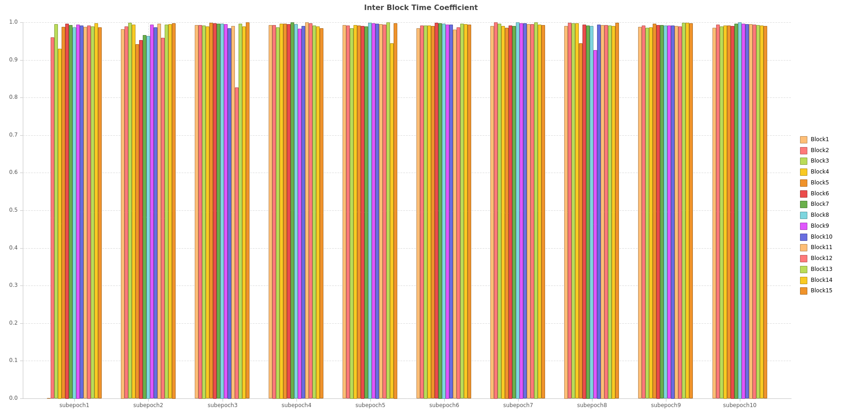
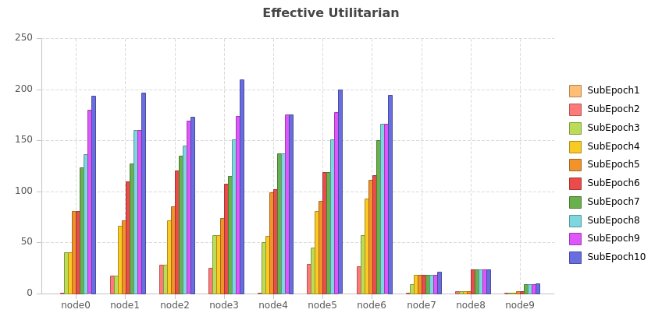
CUPSEC Malicious Node Behavior: Full Block +200ms Latency
Suspended:
SubEpoch7: Node 8 | SubEpoch8: Node 9
IBC during initial phase is low in subepoch 1 but it stabilises from subepoch6 , then is quite uniform. If the malicious node7,8,9 has a fair chance to propose the malicious full block then is compensated by time scheduled fulfiller as fallback.

Slide 31
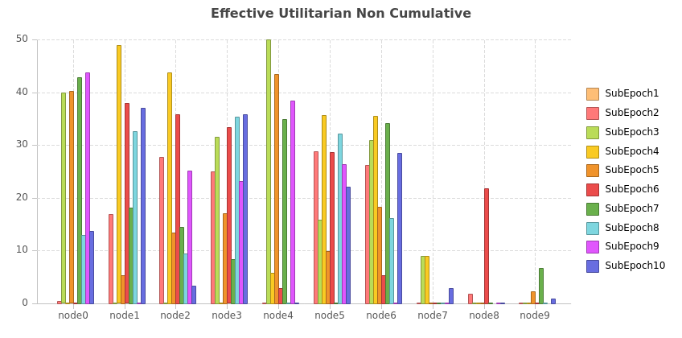
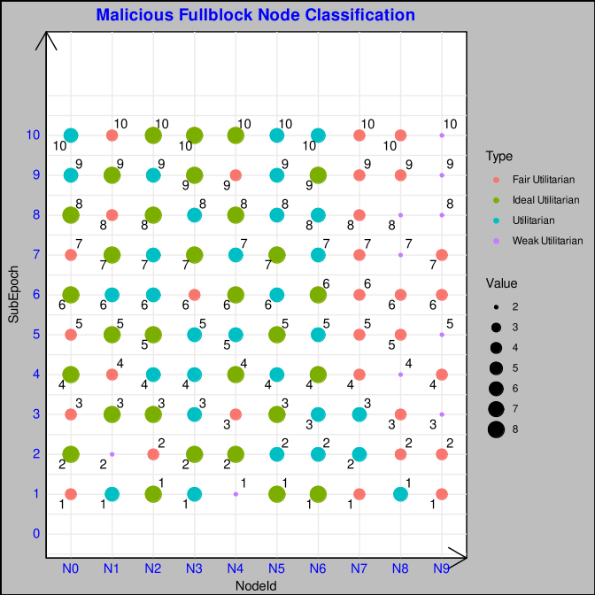
CUPSEC Malicious Node Behavior: Full Block +200ms Latency
Effective Score Non Cumulative is quite low for the
malicious nodes Node7,8,9 as expected.
But observation for for Node 1,2 and 4 also is affected which is due to the missed partial block and commit score in the negative action which is not deliberate. Suspension : SubEpoch7: Node 8 | SubEpoch8: Node 9.
Fairness in classification:
Node 0 and Node 4 is able to progress from Fair Utilitarian and reaches Utilitarian
While Node 1 diminishes due to sustained inadvertent missed partial block and commit score.

Slide 32
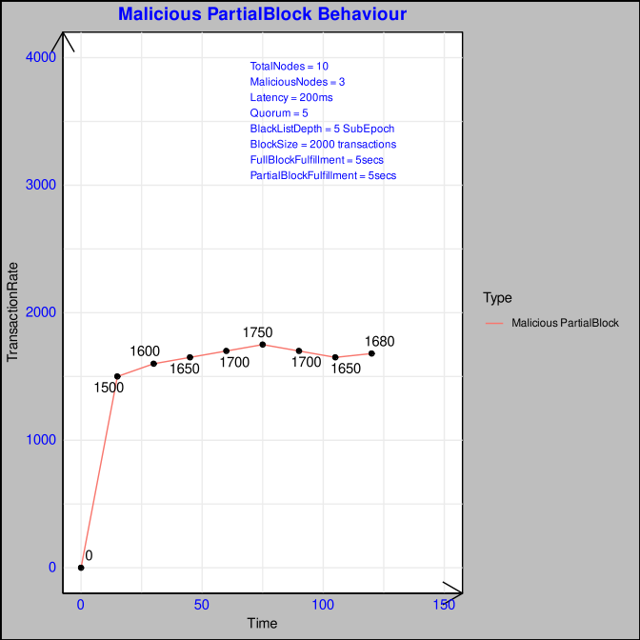
CUPSEC Malicious Node Behavior: Partial Block +200ms Latency
This plot shows that in initial subepoch it starts slow to mount during the optimisation phase and then sustains around 1600 rate.
In comparison of the adverse behavior between malicious partial block and full block, the former renders the system to slow down as partial block proposition whether as missed or gained is malicious.
Missed position of partial block in the ephemeral chain slows down the process for successive position slots at [major,minor] impacting the block finalization at the finalized chain.

Slide 33



CUPSEC Malicious Node Behavior: Partial Block +200ms Latency
Score of Node7,8,9 for partial block proposal is not enlisted as it proposes only malicious partial blocks.
Commit Score is also diminished as latency induces the message to be delayed or irrelevant when it arrives after finalization.
Heart Beat score is more homogeneous as it is scheduled at fixed intervals.

Slide 34


CUPSEC Malicious Node Behavior: Partial Block +200ms Latency
Missed Commit and Partial Block is high in comparison to others as the former is explained by latency and the latter is by purported behavior
Malicious score for Node 7,8,9 is detected by the algorithm.

Slide 35


CUPSEC Malicious Node Behavior: Partial Block +200ms Latency
IBC is quite turbulent with intermittent low coefficient until 5 subepochs but then it is quite high with periodic Intervals.
Cumulative Effective Utilitarian is low for Node7,8,9 as explained by Malicious,Missed Partial, Commit Score.

Slide 36


CUPSEC Malicious Node Behavior: Partial Block +200ms Latency
Effective Utilitarian Non Cumulative is low for Node 7,8,9 nodes as explained by malicious partial block.
Classification of Node7,8,9 hovers between Fair Utilitarian and Weak as they are not able to recover from malicious action.
While Node 4 progresses from a Weak Utilitarian to Ideal Utilitarian, Node 0 moves from Fair to Ideal and finally to Utilitarian exhibiting fairness in the algorithm.

Slide 37

CUPSEC Malicious Node Behavior: Partial Block +200ms Latency [First 100 blocks]
In this nodes 7,8,9 has a delay of 200ms and it proposes a malicious full block for the first 100 blocks or 4 subpeochs.
After the 4 subepochs of malicious and latent behaviour it turns to normal behaviour which improve the transaction finalisation substantially.
E

Slide 38



CUPSEC Malicious Node Behavior: Full Block + Latency: 200ms [First 100 blocks]
Here the Nodes 7, 8, 9 accumulates a comparable score as only 4 subepochs latency is maintained in comparison to throughout behavior discussed earlier.
E

Slide 39


CUPSEC Malicious Node Behavior: Full Block + Latency: 200ms [First 100 blocks]
Negative Scores are high as for the initial latency in proposing partial block as well as committing the partial blocks

Slide 40


CUPSEC Malicious Node Behavior: Full Block + Latency: 200ms [First 100 blocks]
IBC is a bit low initially, but after 4 subepoch it retains a value closer to 1 signifying normal behaviour.
Effective Utilitarian is quite inferior in comparison of nodes 7,8,9 to other nodes.

Slide 41


CUPSEC Malicious Node Behavior: Full Block + Latency: 200ms [First 100 blocks]
Node 7, 8, 9 start out good initially but due to the initial malicious behaviour it falls withing the range of Fair or Weak Utilitarian
Node 1 is inadvertently in weak and Node2 as Fair but continues to progress through the ranks and settles as Fair and Ideal.
At SubEpoch 7: Node 7 is suspended
At Subepoch 8: Node 9 is suspended. Suspension Depth is at 5 to keep optimal, so the intitial malicious behaviour is affecting at subepoch 7. This is in general to keep fairness to give a chance for at least 5 subepochs. But the detection of the malicious block optimises the network.

Slide 42

CUPSEC Malicious Node Behavior: Full Block + Latency: 200ms [First 200 blocks]
This test is for malicious and latency behaviour for 200 blocks and continuous the benign behaviour.

Slide 43



CUPSEC Malicious Node Behavior: Full Block + Latency: 200ms [First 200 blocks]
Node 7,8,9 shows a slight decrease in partial block and commit utilitarian in the intitial subepochs until 8 and then continues to increase
While heart beat has a higher time bound of 5 secs, an eventual reception it does not decrease.

Slide 44


CUPSEC Malicious Node Behavior: Full Block + Latency: 200ms [First 200 blocks]
Malicious Score for Node 7,8,9 is quite high in comparison to other nodes and then shows a gradual decrease as it falls back to normal behaviour.

Slide 45


CUPSEC Malicious Node Behavior: Full Block + Latency: 200ms [First 200 blocks]
Node 7,8,9 has an effective utilitarian low due to the latency and malicious behaviour.
Also the IBC Coefficient is low for subepochs upto 8 and then it normalises to 1.

Slide 46


CUPSEC Malicious Node Behavior: Full Block + Latency: 200ms [First 200 blocks]
Suspension: SubEpoch7: Node 9
Node 7,8 and 9 is hovering between Fair and Weak Utilitarian.
Node 9 is suspended which optimises the network as the malicious member doesnt participate in the consensus.
Node 2 and 4 on the other hand progresses from weak and fair respectively to Ideal Utilitarian and Utilitarian

Slide 47


CUPSEC Malicious Node Behavior: Full Block + Latency: 200ms [50-100, 150-200, 250-300, 350-400]
In this test the Nodes behave maliciously intermittently at repeated intervals similar to a pattern of Sine Wave
So there is a period of transaction drop and then optimisation follows which makes the network to be resilient and suspend the malicios nodes to path of restoration.
Malicious:50 - 100
Malicious:150 - 200
Normal:0 - 50
Normal:100 - 150
Normal:250 - 300

Slide 48



CUPSEC Malicious Node Behavior: Full Block + Latency: 200ms [50-100, 150-200, 250-300, 350-400]
As expected Node 7, 8 and 9 have a drop in positive score of Partial Block, Commit Message in the sine interval.

Slide 49


CUPSEC Malicious Node Behavior: Full Block + Latency: 200ms [50-100, 150-200, 250-300, 350-400]
Missed Partial and Commit is due to the latency exhibited by the Nodes 7,8 and 9 in a sine wave pattern.

Slide 50


CUPSEC Malicious Node Behavior: Full Block + Latency: 200ms [50-100, 150-200, 250-300, 350-400]
As noted the IBC is low at the initial subepoch and then recovering due to optimisation it achieves a stable behaviour.
Effective Utilitarian non cumulative as evident by its behaviour is low.

Slide 51


CUPSEC Malicious Node Behavior: Full Block + Latency: 200ms [50-100, 150-200, 250-300, 350-400]
Effective Utilitarian non cumulative as evident by its
behaviour is low but since its non cumulative we see a
Sinusoidal pattern in its score.
Suspended Nodes:
SubEpoch 7: Node 7
Node 7 is suspended and Node 8,9 will follow suit as it lies in the lower slab of fair utilitarian

Slide 52

Overall Comparison Transaction Rate and Scalability
Overall comparison of consensus algorithms simulated:
Clique: It shows a smooth gradient drop with respect to scalability as discussed earlier but is not steep as it is more of block proposal broadcast rather than majority votes for multiple phases of consensus.
PBFT: With 4 phases of Pre-Prepare,Prepare,Commit and Round Change plus the N*(N-1) for each phase augments the message complexity load bringing down the transaction rate.
IBFT: It is a lighter version of PBFT with Prepare, Commit and Round Change which is better but suffers due to block locking.
QBFT: Similar to IBFT but without blocklocking scales better.
Utilitarian: For 5,10 Nodes compared to 15,20 and 25 it improves the parallelization factor. It shows a Z shaped plot which ascends until 15 Nodes for 6 Quorums which is a balance between IntraQuorum and InterQuorum Message but at the same quorum membership for 20, 25 Nodes it augments the intraquorum communication.
Ideal Quorum Membership is necessary to balance between IntraQuorum, Security and Liveness Factor
Utilitarian Implicit: It is a more lighter form of Utilitarian and performs slightly better than it with one reduced phase Finalise compared to Prepare,Commit,Finalise.

Slide 53

Overall Comparison: Normalisation
Normalisation is calculated by the maximum transaction rate for each consensus.
Normalisation Comparison between simulated and actual binary show a similar behaviour which exhibits an almost smooth convex curve for PBFT,IBFT signifying scalability drop. It is a rugged concave for QBFT,Clique.
Normalisation shows Z shape for Utilitarian, Utilitarian Implicit, it can be inverted V for more optimised quorum membership but can affect the fault tolerance, liveness and safety property.

Slide 54

Overall Comparison: Scalability Gradient
In looking from a scalability perspective, PBFT shows wide gradience due to its multiplying communication complexity with all the nodes combined with multiple phases of consensus.
Clique gradience is quite smooth as its more of a proposal and acceptance without acknowledgement by its participants which is the root cause of forks.
IBFT as is more gradual with lesser phases compared to PBFT and increasing a bit with more nodes.
QBFT is very minimal in initial threshold upto 15 nodes and then a steep rise in scalability drop is obtained as risen by the phases and message complexity
In Utilitarian it is more comparable with QBFT when after 15 nodes we notice a drop but it is less than the former. Its combination of Intra-Quorum and Inter-Quorum reduces the message communication complexity.
Also the presence of utilitarian score helps in optimisation and reorganisation of the network drooping malicious nodes. It regains the nodes on its restoration or recovery to good behaviour ensuring fairness of opportunity.

Slide 55

Overall Comparison: Fault Gradient
Fault Throughout presents a more drastic drop as the nodes are more of not in recovery but intend to bring the transaction rate.
Since in this case both common to MFB and MFB, suspending the members upto 3 reduces fault tolerance which reduces the transaction rate.
In other case of intermittent malicious behavior the scalability drop is not quite high, it has a recovery path.

Slide 56
Conclusion
In ideal Quorum to Member ratio the Utilitarian shows a more acceptable scalability conditions with the recovery due to quorum optimisation at the end of each subepoch
In the case of inadvertent faults (not conscient) the network can reorganize and ensure the performance of the network.
In case of advertent behaviour as discussed earlier the nodes can ensure resilience but ensuing suspension of nodes should be offset by adequate remaining nodes to ensure liveness.

Slide 57



Slide 58


Voting on Chains and not blocks
Drawbacks: https://www.youtube.com/watch?v=ZmIa_4hPRZ8
BEEFY

Slide 59
Pointers
Transaction Ordering
Election Manipulation
Fork Discussion
Attack Scenario & Profit Strategy
Scenario: ?? Resiliency, Optimization,Evolution Behaviour ( Initial: Malicious and Later: Recover)
Can we use the score to give a fair chance to propose a block/partial/quorum or that limits the opportunity too much in a consortium? (Fairness vs security perspective vs liveness argument vs Fault Tolerance)
Latency vs Faulty
Phragmen Voting is our case?

Slide 60
Feedback
M . Verdier:
Hashing: Cite more and verify the performance
Langage de Development: Rust
Mesh --> Change to Full Connected Mesh
Scalability Gradient -→ ?? To Change, Not Representative
PBFT Nature Article : To discuss in grand detail and verify if there are any corrections.
Optimum Quorum No? How and What? Refer fpc ??????///////
Profondément Etudier – SubEpoch Change – Explain well?
To Look:
https://www.mdpi.com/2076-3417/11/20/9372
A Coordination Technique for Improving Scalability of Byzantine Fault-Tolerant Consensus
https://www.researchgate.net/publication/346520550_A_Scalable_Multi-layer_PBFT_Consensus_for_Blockchain
Phragmen Voting
Taxonomy , Greedy Heuristic, Network Partition resilience (star fish property) ?
\ref{Simulator Deployment}

Slide 61


Feedback
13) Reattachement | Equivocation refer
14 ) Hybrid Consensus : CASPER FFG | The Ghost protocol in Ethereum is (Greedy Heaviest Observed Subtree)

